Slide 1
Data mining

Slide 2
Data mining is the process of discovering useful patterns, relationships, trends, and knowledge from large amounts of data using statistical, mathematical, and machine learning techniques.
It helps organizations make informed decisions and predict future outcomes.
Importance of Data Mining
Improves decision-making
Detects hidden patterns in data
Predicts future trends
Enhances customer relationship management
Reduces business risks
Increases organizational efficiency

Slide 3
DATA MINING PROCESS
Business Understanding: This step defines the goals of the data mining project and what insights you're looking for.
Data Understanding: Here, you get familiar with the data available, its format, and any initial quality issues.
Data Preparation: This crucial step cleanses, integrates, reduces, and transforms the data into a usable format for modeling. Data Cleaning, Data Integration, Data Reduction, Scaling, encoding, and normalization for better modeling, Data Discretization- Grouping continuous values into categories.

Slide 4
DATA MINING PROCESS CONT……
Modeling: Involves choosing and applying data mining algorithms based on your goals (e.g., classification, clustering, prediction). Model Evaluation: Here, you assess the model's performance and accuracy using various metrics.
Deployment: If the model performs well, it's deployed to generate insights or predictions on new data.
Results: This is where you interpret the findings from the model and use them to make informed decisions.

Slide 5
DATA MINING TASKS
Classification: Classification is the process of assigning data into predefined categories or classes.
Example:
Email: Spam or Not Spam
Loan Applicant : Approved or Rejected
Common Algorithms
Decision Tree
Naïve Bayes
Support Vector Machine (SVM)
Notes:
Data Mining Tasks: Data mining tasks are the specific activities performed to discover useful information, patterns, and knowledge from data.

Slide 6
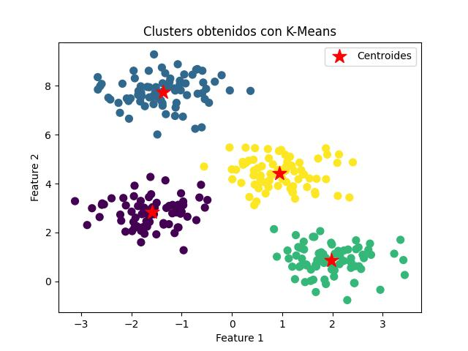
DATA MINING TASKS
Clustering: Clustering groups similar data items together without predefined classes.
Example
A supermarket groups customers according to purchasing behavior.
Common Algorithms
K-Means
Hierarchical Clustering
Notes:
Data Mining Tasks: Data mining tasks are the specific activities performed to discover useful information, patterns, and knowledge from data.

Slide 7
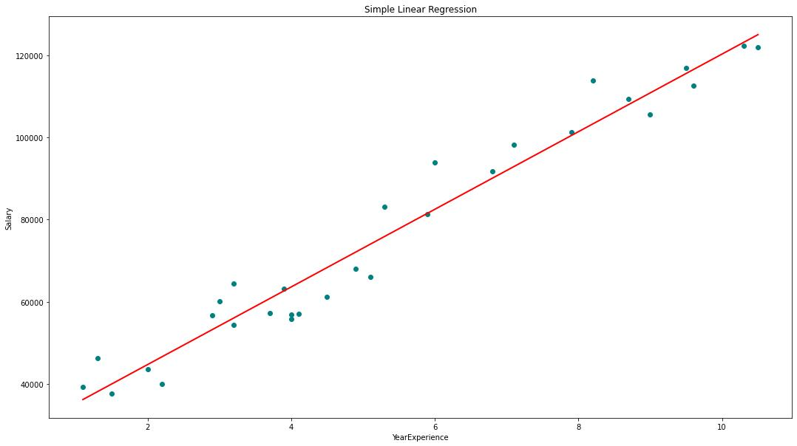
DATA MINING TASKS
Regression: predicts continuous numerical values.
Example
Predicting:
House prices
Temperature
Income
Applications
Financial analysis
Economic forecasting
Price estimation
Notes:
Data Mining Tasks: Data mining tasks are the specific activities performed to discover useful information, patterns, and knowledge from data.

Slide 8
Regression Vs Classification
Regression predicts continuous numerical values (e.g., price, temperature) using algorithms like Linear Regression.
Classification predicts discrete class labels (e.g., spam/not spam) using algorithms like Logistic Regression and SVM.
Regression answers "How much?" or "What is the value?", while classification answers "What category?".
Regression outputs numbers, while classification outputs class labels or probabilities.
Notes:
Data Mining Tasks: Data mining tasks are the specific activities performed to discover useful information, patterns, and knowledge from data.

Slide 9
Regression, Classification, Clustering
Notes:
Data Mining Tasks: Data mining tasks are the specific activities performed to discover useful information, patterns, and knowledge from data.

Slide 10
Regression, Classification, Clustering
Notes:
Data Mining Tasks: Data mining tasks are the specific activities performed to discover useful information, patterns, and knowledge from data.

Slide 11
Types of Data Mining Architectures
Single-Tier Architecture
Two-Tier Architecture
Three-Tier Architecture
Notes:
Data Mining Tasks: Data mining tasks are the specific activities performed to discover useful information, patterns, and knowledge from data.

Slide 12
Single-Tier Architecture
A Single-Tier Architecture is the simplest architecture where the database, data mining engine, and user interface are all located in one system.
Characteristics
All components are in one computer.
Suitable for small datasets.
Advantages
Easy to implement.
Low cost.
Fast for small datasets.
Disadvantages
Poor scalability.
Limited security.
Not suitable for large organizations.
Notes:
Data Mining Tasks: Data mining tasks are the specific activities performed to discover useful information, patterns, and knowledge from data.

Slide 13
Two-Tier Architecture
A Two-Tier Architecture consists of a client and a server. The client communicates directly with the server, which stores the data and performs data mining operations.
Characteristics
Client sends requests directly to the server.
Data and mining functions are stored on the server.
Advantages
Centralized data management.
Better security than single-tier.
Easier data sharing.
Disadvantages
Server may become overloaded.
Dependent on server availability.
Notes:
Data Mining Tasks: Data mining tasks are the specific activities performed to discover useful information, patterns, and knowledge from data.

Slide 14
Three-Tier Architecture
A Three-Tier Architecture separates the system into three layers:
Presentation Layer
Application Layer
Data Layer
Presentation Layer
Interacts with users.
Displays reports, dashboards, and graphs.
Application Layer
Contains business logic.
Executes data mining algorithms.
Data Layer
Stores databases and data warehouses.
Notes:
Data Mining Tasks: Data mining tasks are the specific activities performed to discover useful information, patterns, and knowledge from data.

Slide 15
Three-Tier Architecture
Advantages
Highly scalable.
Better security.
Easy maintenance.
High performance.
Disadvantages
More complex.
Higher implementation cost.
Notes:
Data Mining Tasks: Data mining tasks are the specific activities performed to discover useful information, patterns, and knowledge from data.

